Slide 1
Applied Data Science L11. Decision Trees
Irina Mohorianu
Head of Bioinformatics/ Scientific Computing @CSCI

Slide 2
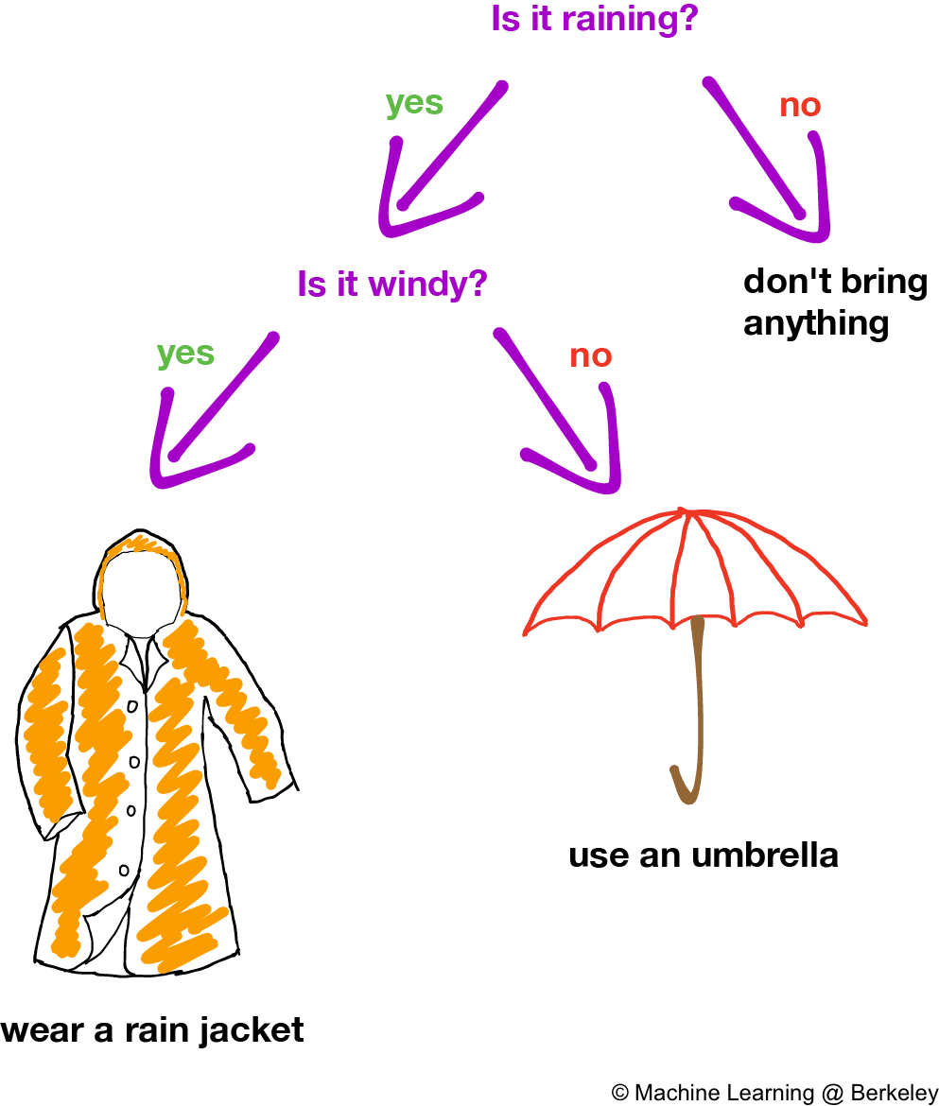
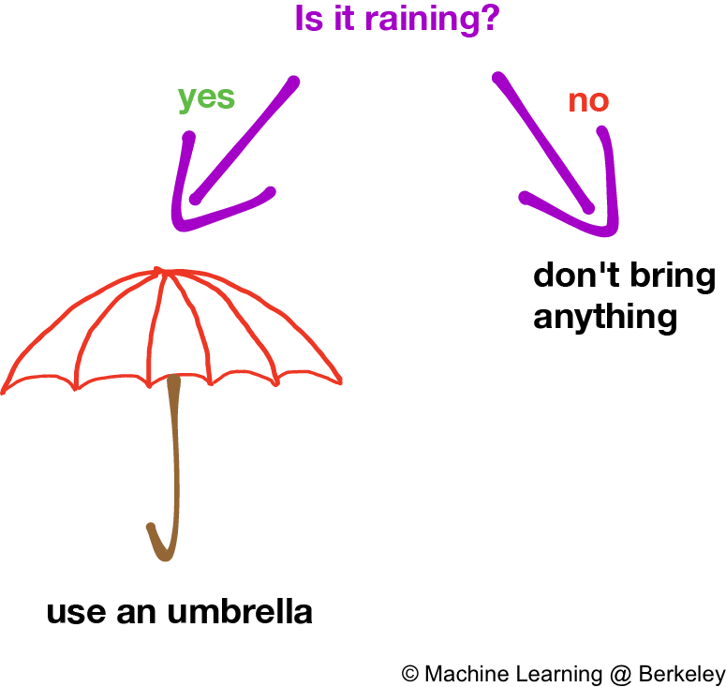
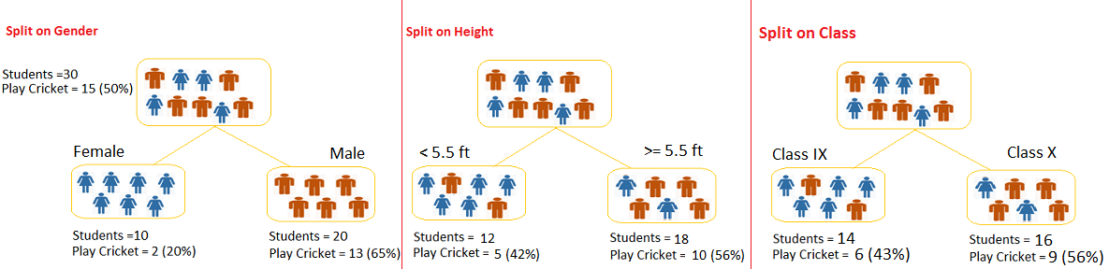
Decision trees. Definitions
What is a Decision Tree?
Decision tree or recursive partitioning is a supervised graph based algorithm to represent choices and the results of the choices in the form of a tree.
The nodes in the graph represent an event or choice and it is referred to as a leaf and the set of decisions made at the node is referred to as branches.
Decision trees map non-linear relationships and the hierarchical leaves and branches make a Tree.

Slide 3
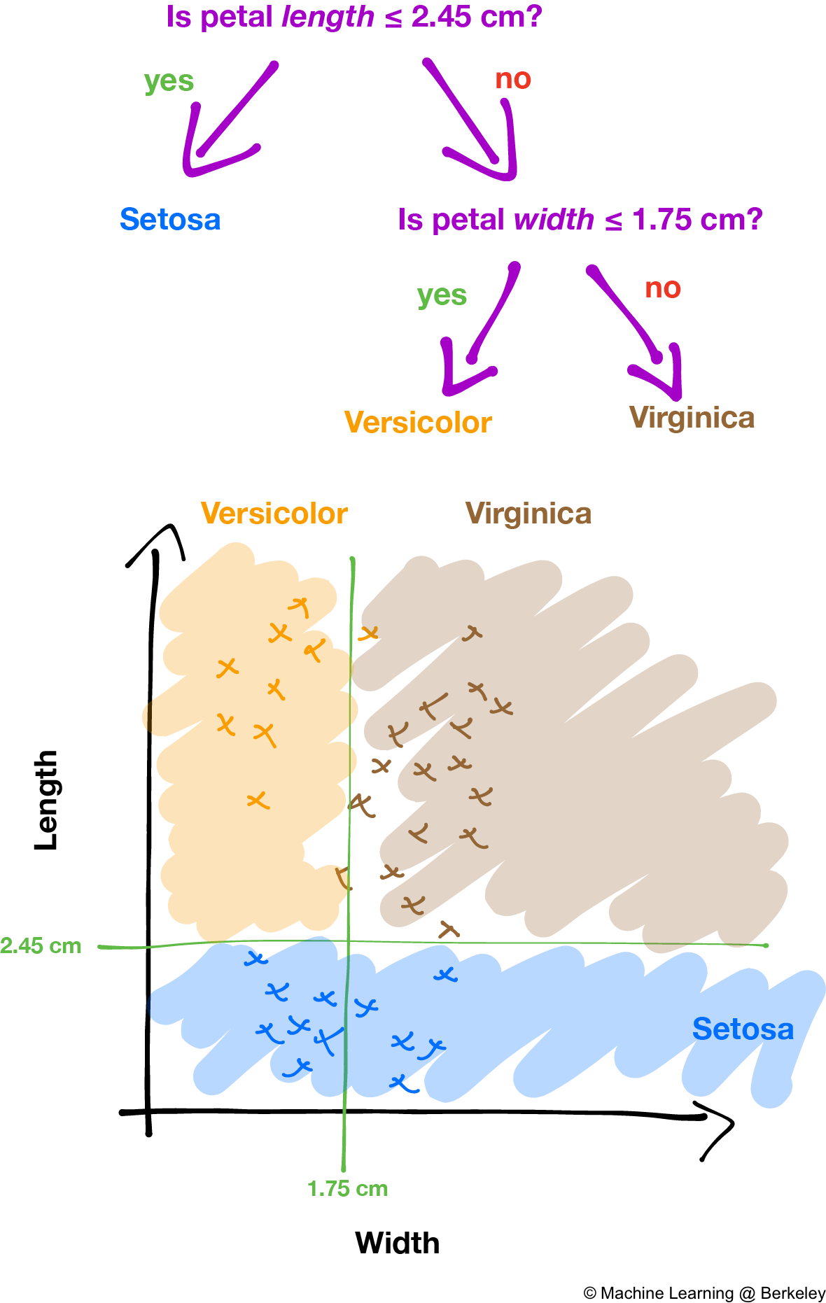
Decision trees. Definitions Splitting decision
The classification tree searches through each dependent variable to find a single variable that splits the data into two or more groups and this process is repeated until the stopping criteria is invoked.
The decision of making strategic splits heavily affects a tree’s accuracy. The decision criteria is different for classification and regression trees.
Decision trees use multiple algorithms to decide to split a node in two or more sub-nodes. The common goal for these algorithms is the creation of sub-nodes with increased homogeneity. In other words, we can say that purity of the node increases with respect to the target variable. Decision tree splits the nodes on all available variables and then selects the split which results in most homogeneous sub-nodes.

Slide 4
Decision trees Splitting criteria
Node splitting, or simply splitting, divides a node into multiple sub-nodes to create relatively pure nodes. This is done by finding the best split for a node and can be done in multiple ways. The splitting can be broadly divided into two categories based on the type of target variable:
Continuous Target Variable: Reduction in Variance
Categorical Target Variable:
Gini Impurity, Information Gain, and Chi-Square

Slide 5
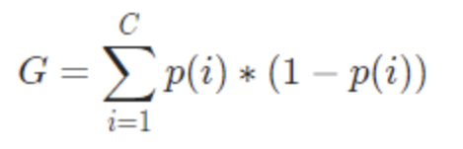
Decision trees Splitting criteria
Gini Index The Gini Index or Gini Impurity is calculated by subtracting the sum of the squared probabilities of each class from one. It favours mostly the larger partitions and are very simple to implement. In simple terms, it calculates the probability of a certain randomly selected feature that was classified incorrectly.
The Gini Index varies between 0 and 1, where 0 represents purity of the classification and 1 denotes random distribution of elements among various classes. A Gini Index of 0.5 shows that there is equal distribution of elements across some classes.
The Gini Index works on categorical variables and gives the results in terms of “success” or “failure” and hence performs only binary split. It isn’t computationally intensive as its counterpart – Information Gain. From the Gini Index, the value of another parameter named Gini Gain is calculated whose value is maximised with each iteration by the Decision Tree to get the perfect CART

Slide 6
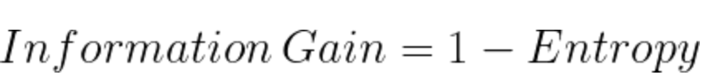
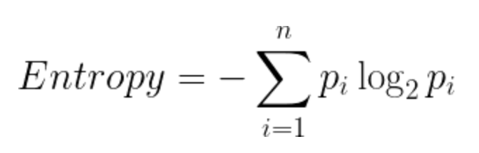
Decision trees Splitting criteria
Information Gain
Entropy is used for calculating the purity of a node. The lower the value of entropy, the higher the purity of the node. The entropy of a homogeneous node is zero. Since we subtract entropy from 1, the Information Gain is higher for the purer nodes with a maximum value of 1.
Steps to split a decision tree using Information Gain:
[1] For each split, individually calculate the entropy of each child node
[2] Calculate the entropy of each split as the weighted average entropy of child nodes
[3] Select the split with the lowest entropy or highest information gain
[4] Until you achieve homogeneous nodes, repeat steps 1-3

Slide 7
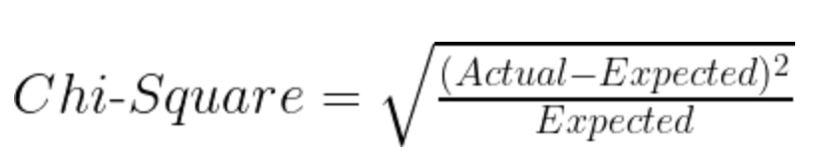
Decision trees. Splitting criteria
ChiSq approach – multiple output classes
the Expected is the expected value for a class in a child node based on the distribution of classes in the parent node, and the Actual is the actual value for a class in a child node.
The higher the value, the higher will be the differences between parent and child nodes, i.e., the higher will be the homogeneity.
[1] For each split, individually calculate the Chi-Sq value of each child node
i.e. taking the sum of Chi-Sq values for each class in a node
[2] Calculate the Chi-Sq value of each split as the sum of Chi-Sq values for all the child nodes
[3] Select the split with a higher Chi-Square value
[4] Until you achieve homogeneous nodes, repeat steps 1-3

Slide 8
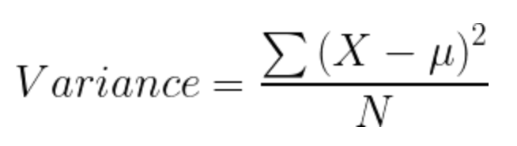
Decision trees Splitting criteria. Continuous output
Variance is used for calculating the homogeneity of a node. If a node is entirely homogeneous, then the variance is zero.
The steps to split a node in a tree using the reduction in variance method:
[1] For each split, individually calculate the variance of each child node
[2] Calculate the variance of each split as the weighted average variance of child nodes
[3] Select the split with the lowest variance
[4] Perform steps 1-3 until completely homogeneous nodes are achieved

Slide 9
Decision trees Advantages. Disadvantages
Some parameters used for building a tree and constrain overfitting
Minimum sample for a node split
Minimum sample for a terminal node
Maximum depth of a tree
Maximum number of terminal nodes
Maximum features considered for a split
Advantages of decision tree
[1] Simple to understand and use
[2] Algorithms are robust to noisy data
[3] Useful in data exploration
decision tree is non parametric no assumptions on the distribution of variables
Disadvantages of decision tree
1.Overfitting is the common disadvantage of decision trees [also trees can get trapped into local optima]. Can be partially addressed by constraining the model parameter and by pruning.
2. It is not ideal for continuous variables as in it looses information

Slide 10
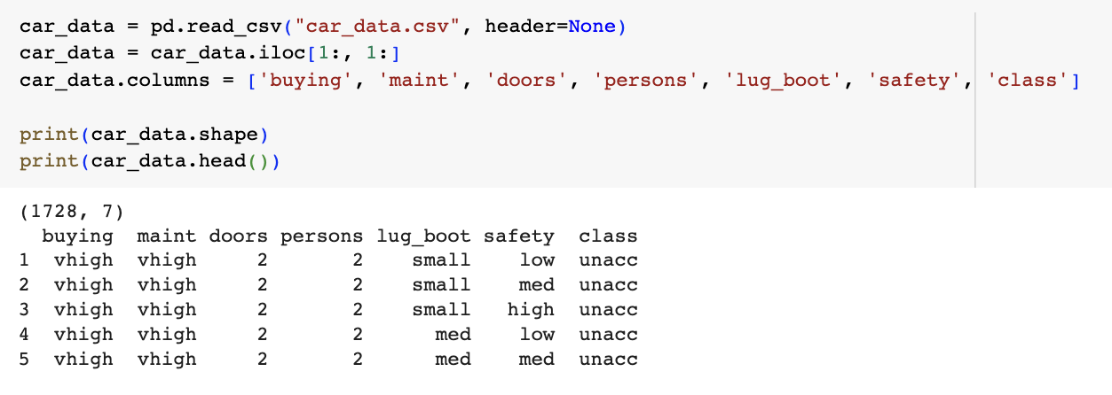
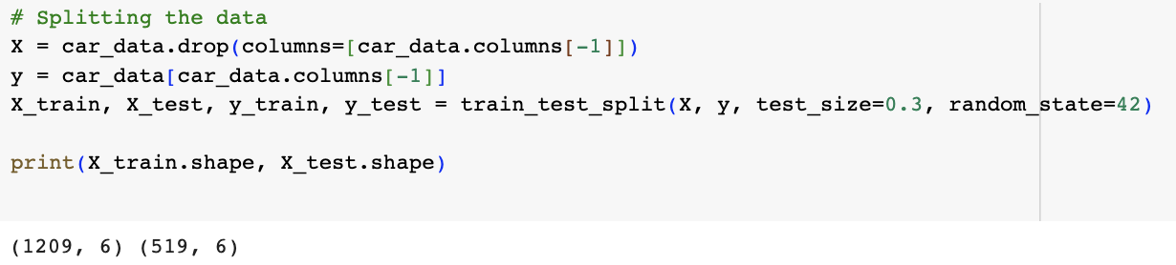
Decision trees. Example 1. Car dataset

Slide 11
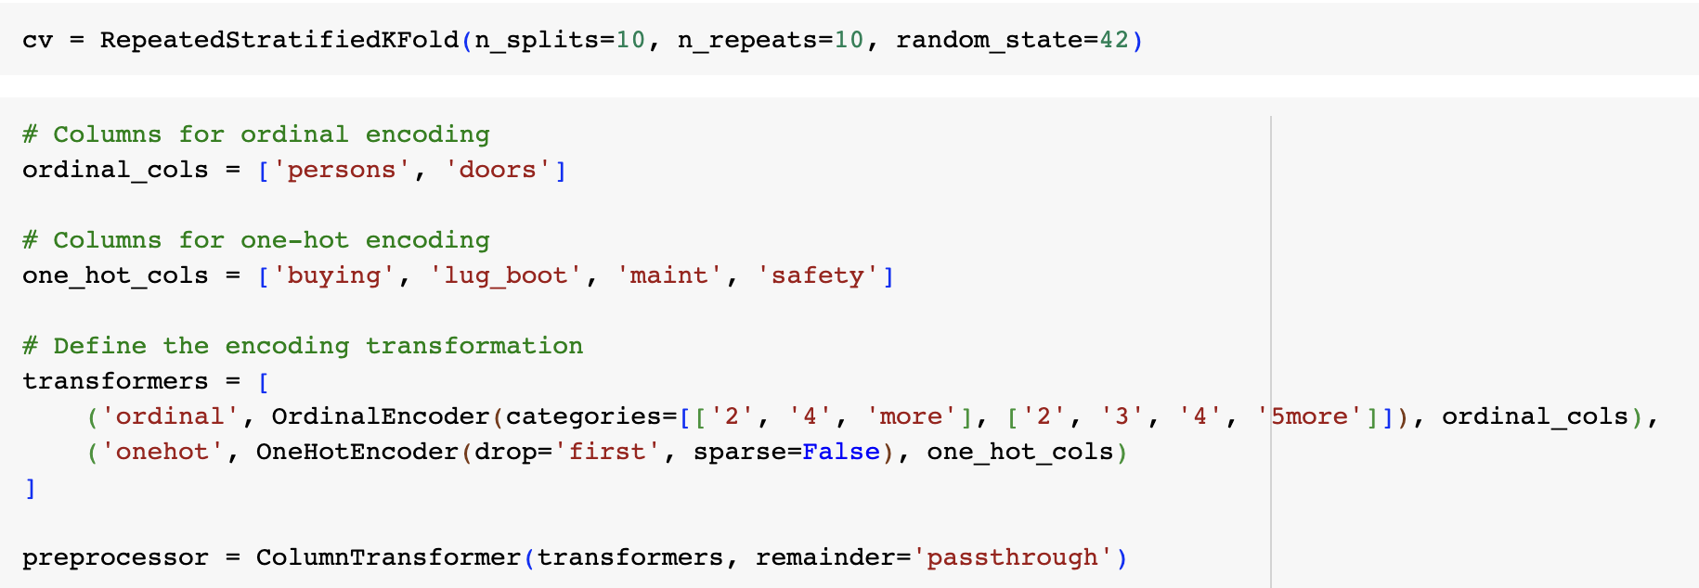
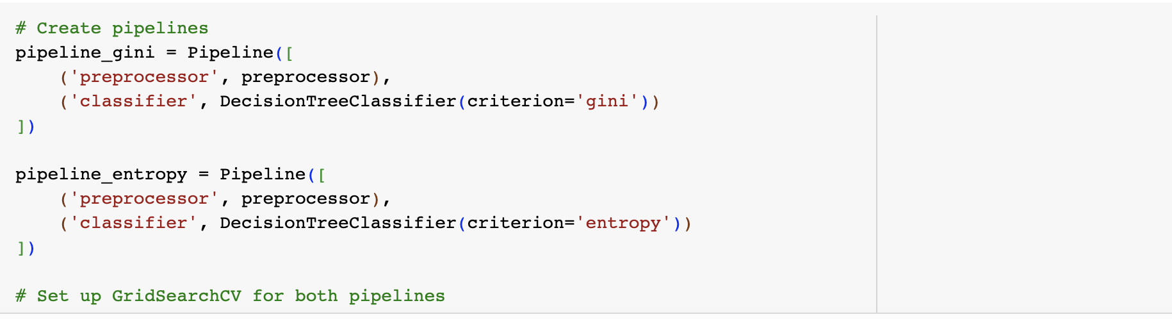
Decision trees Example 1. Car dataset

Slide 12
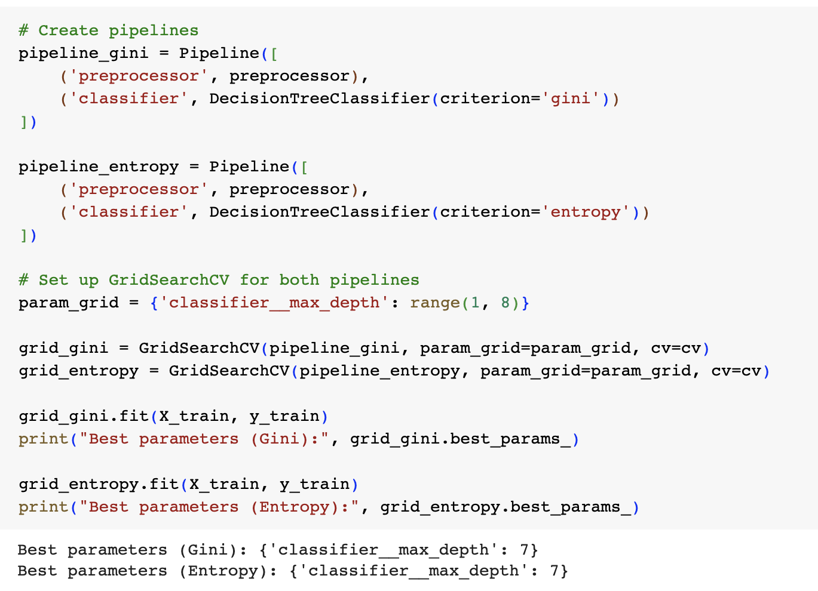
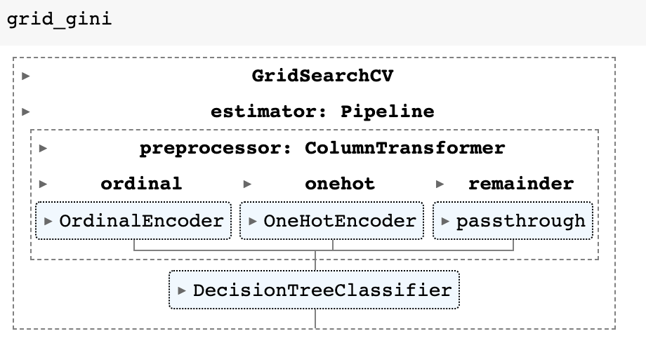
Decision trees Example 1. Car dataset

Slide 13
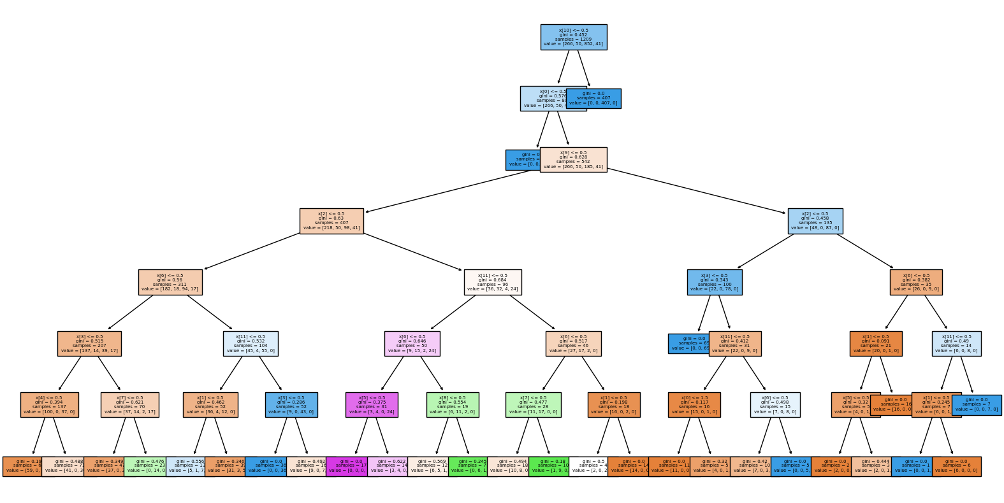
Decision trees Example 1. Car dataset. Gini

Slide 14
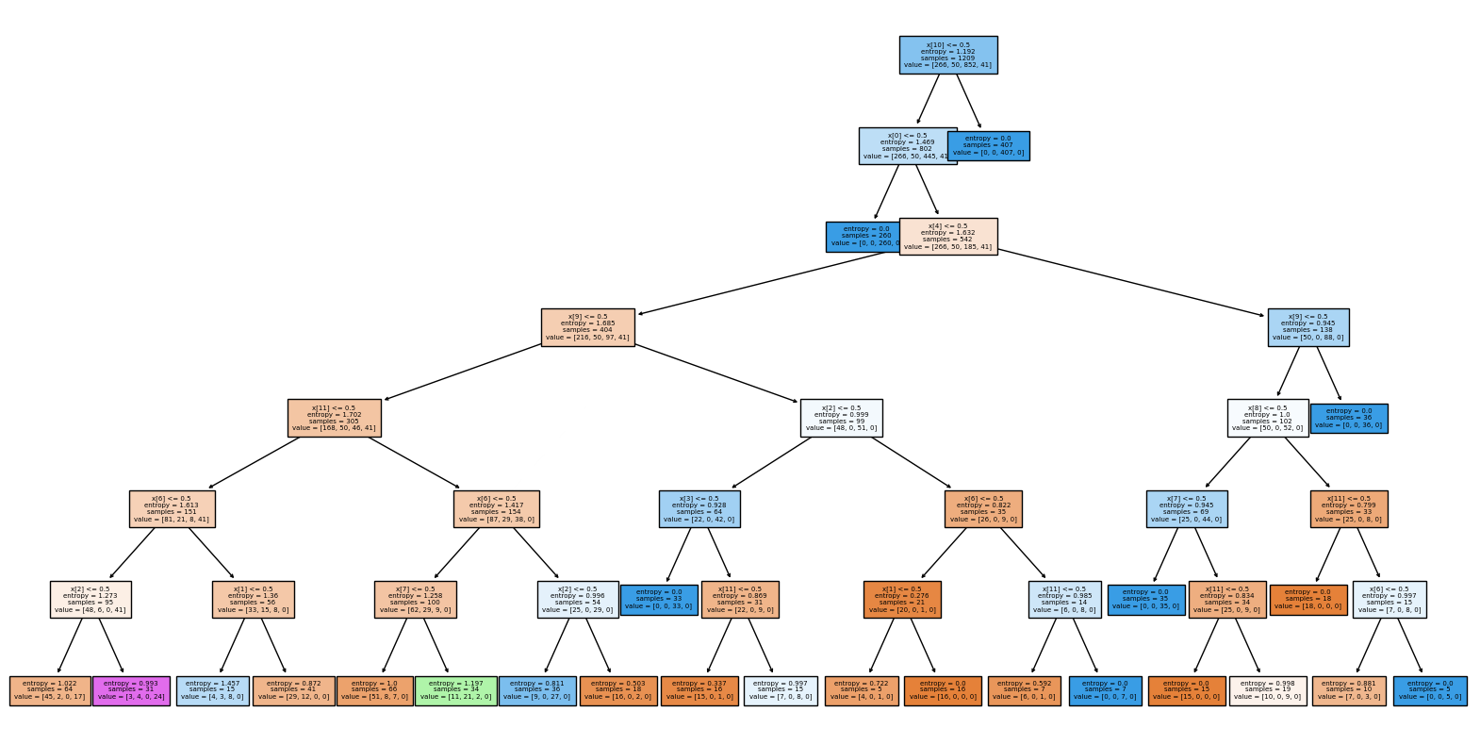
Decision trees Example 1. Car dataset. Entropy

Slide 15
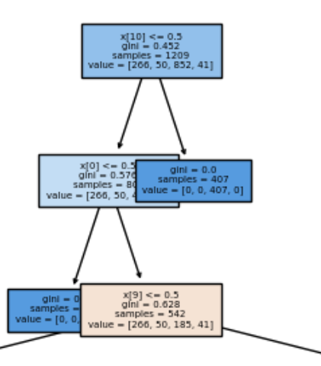
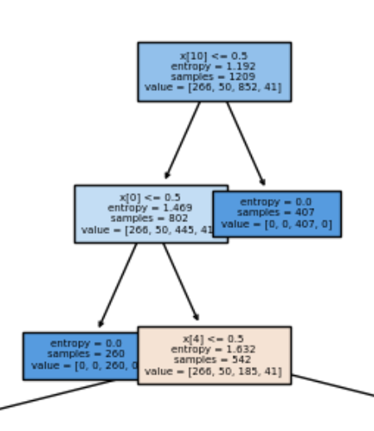
Decision trees Example 1. Car dataset
Gini index
Entropy

Slide 16
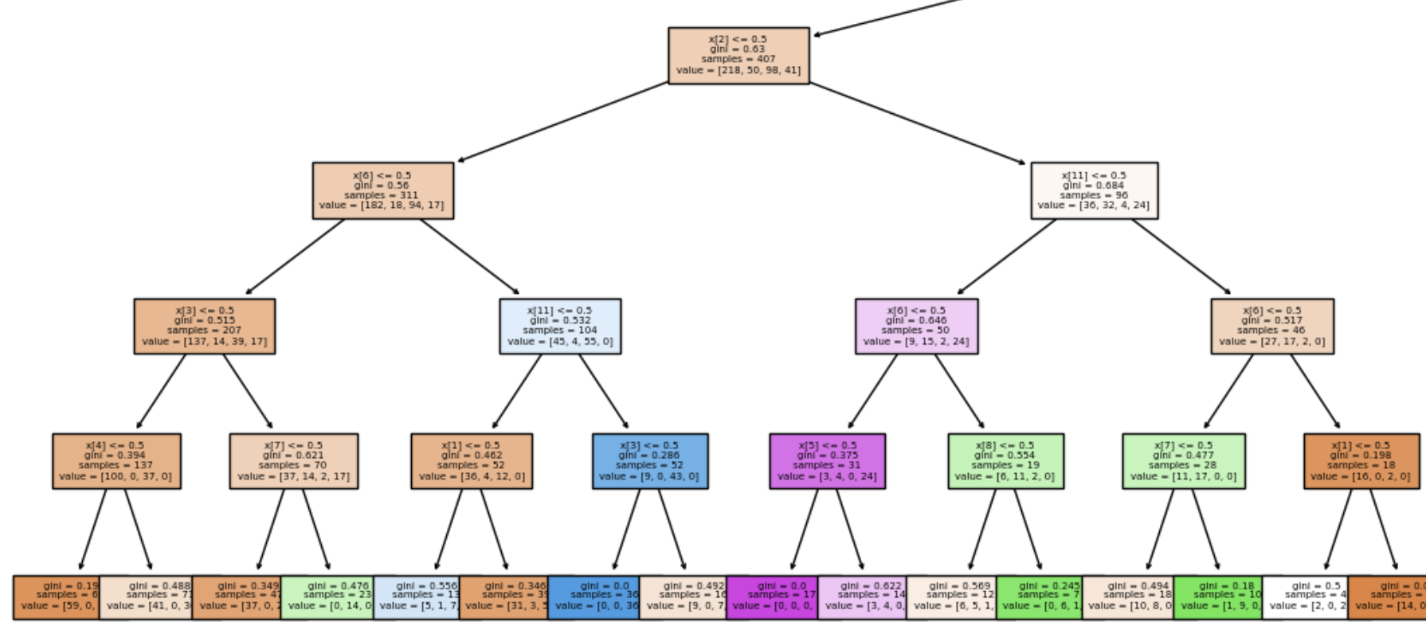
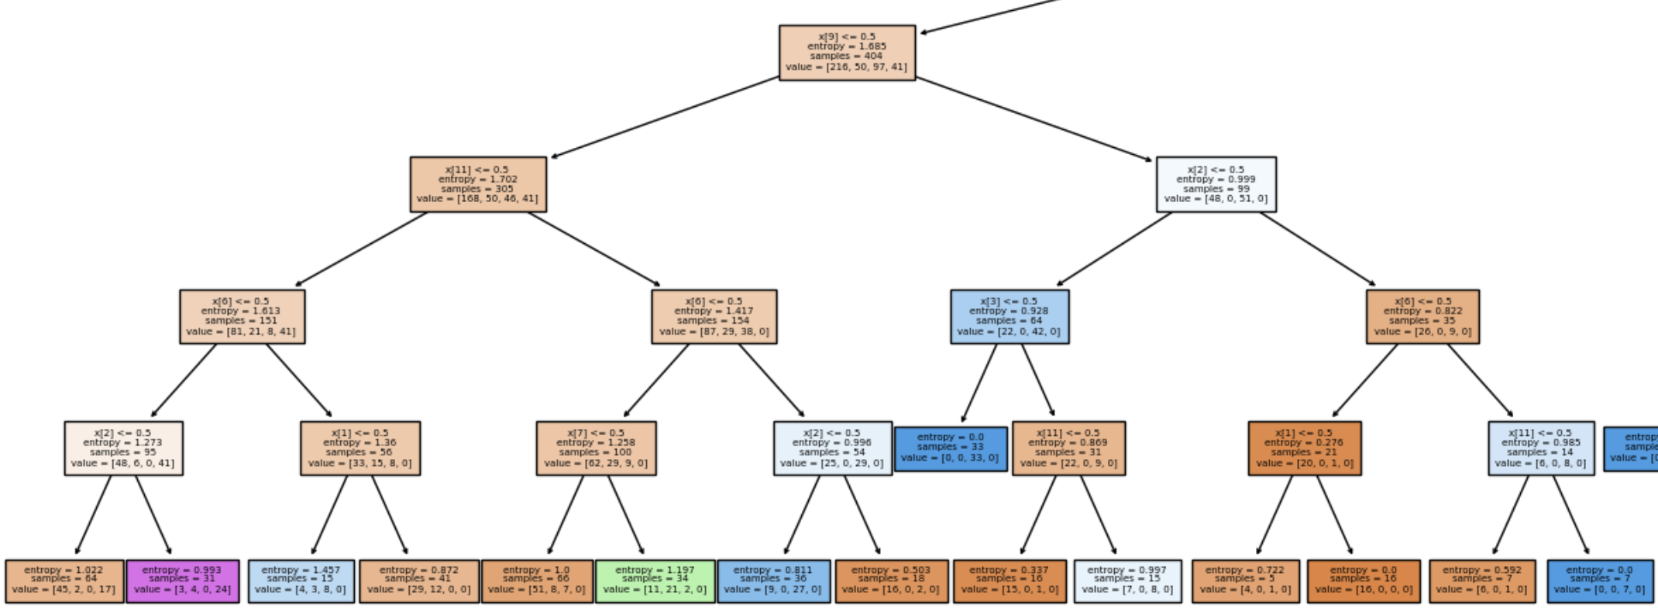
Decision trees Example 1. Car dataset
Gini index
Entropy

Slide 17
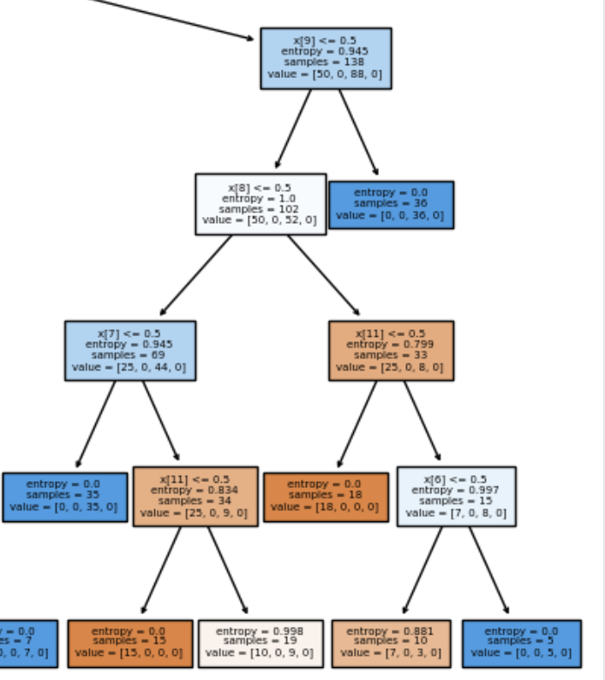
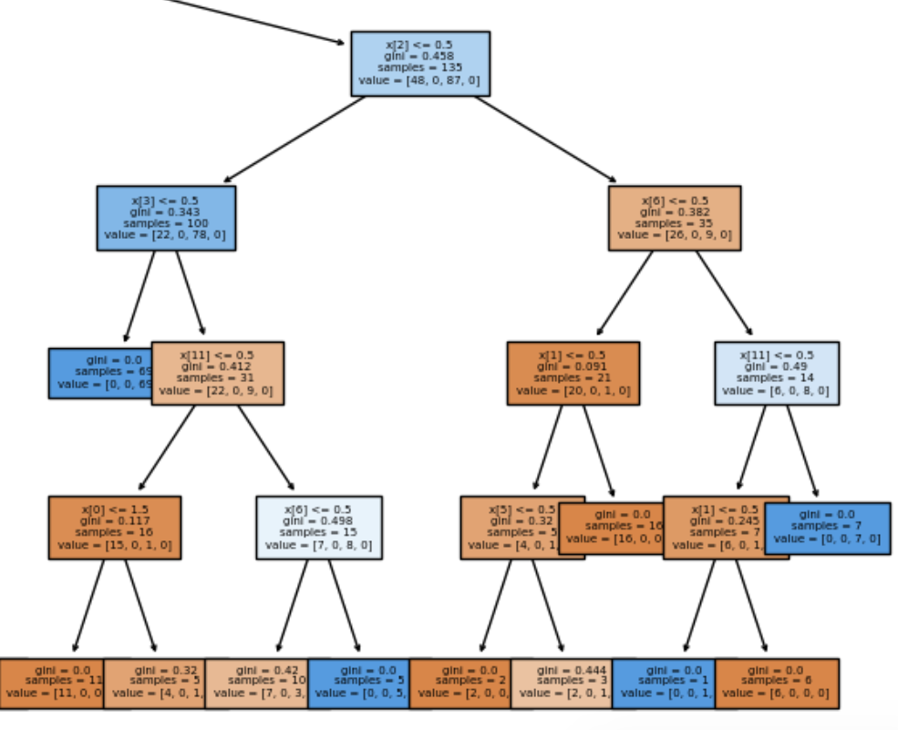
Decision trees Example 1. Car dataset
Gini index
Entropy

Slide 18
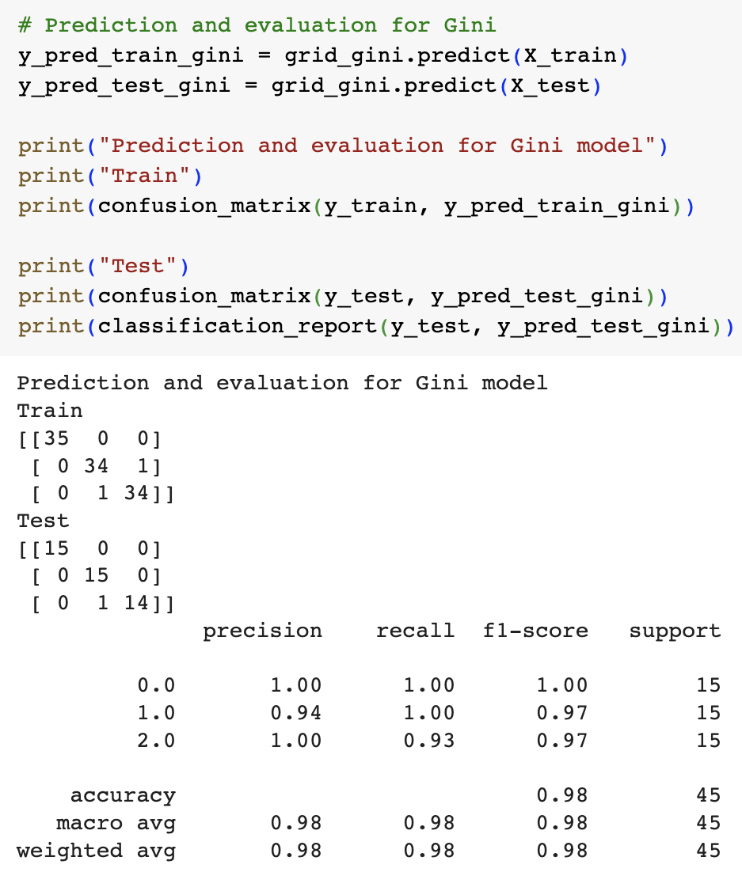
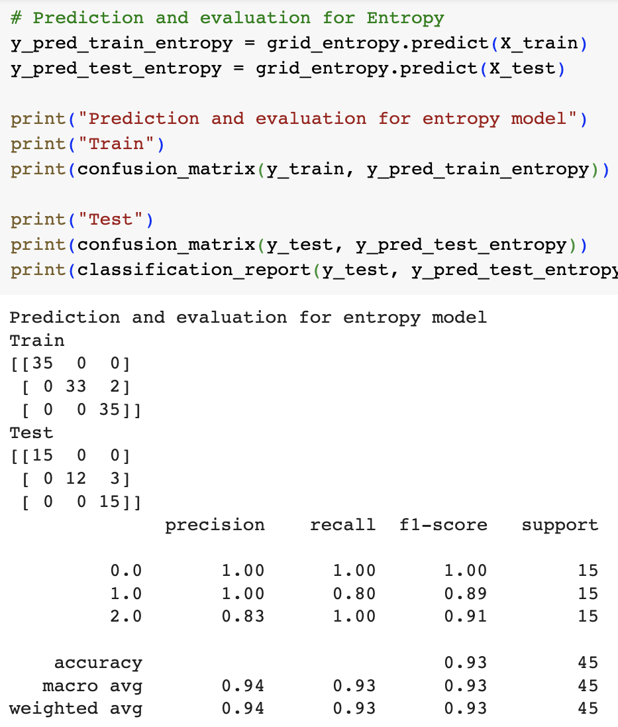
Decision trees Example 1. Car dataset

Slide 19
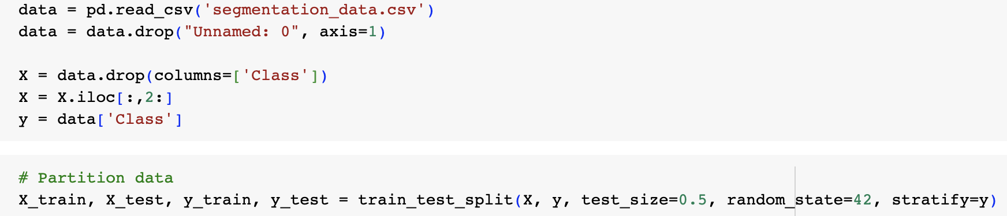
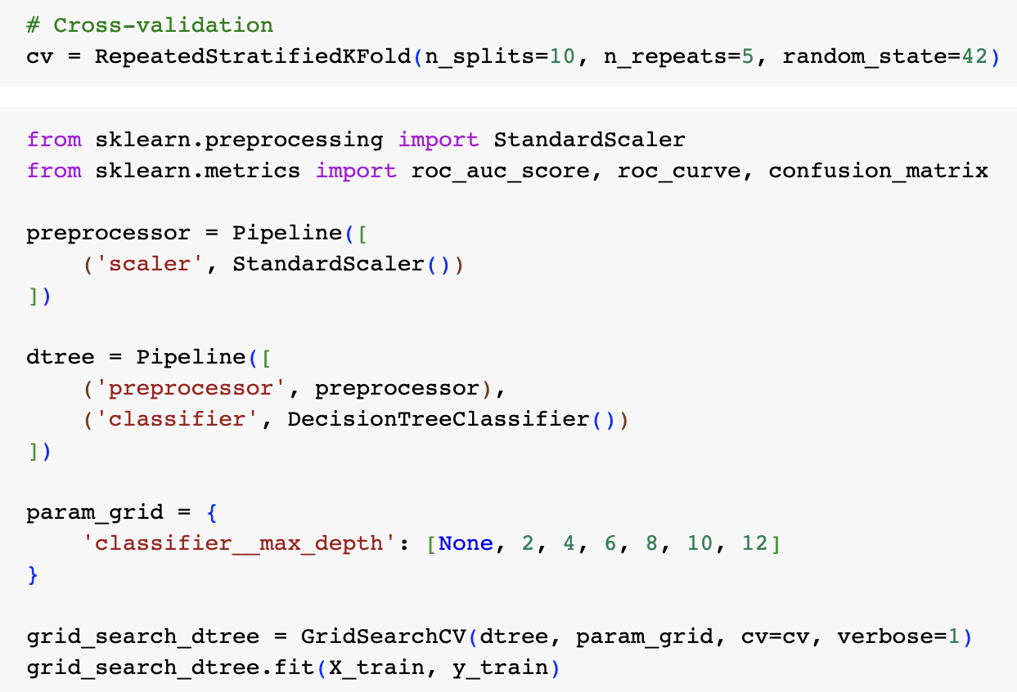
Decision trees Cell Segmentation example

Slide 20
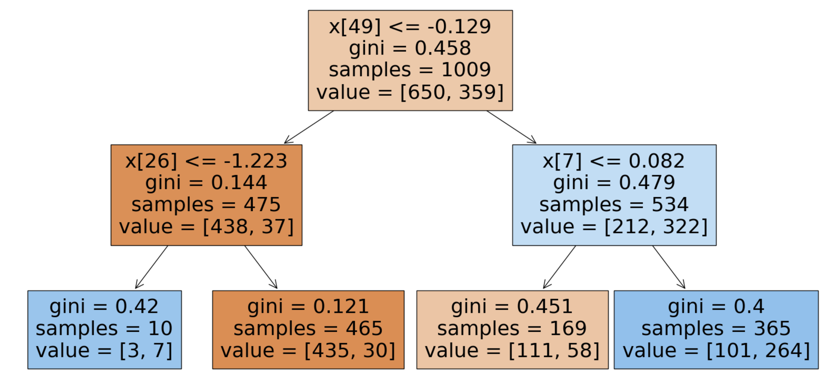
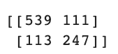
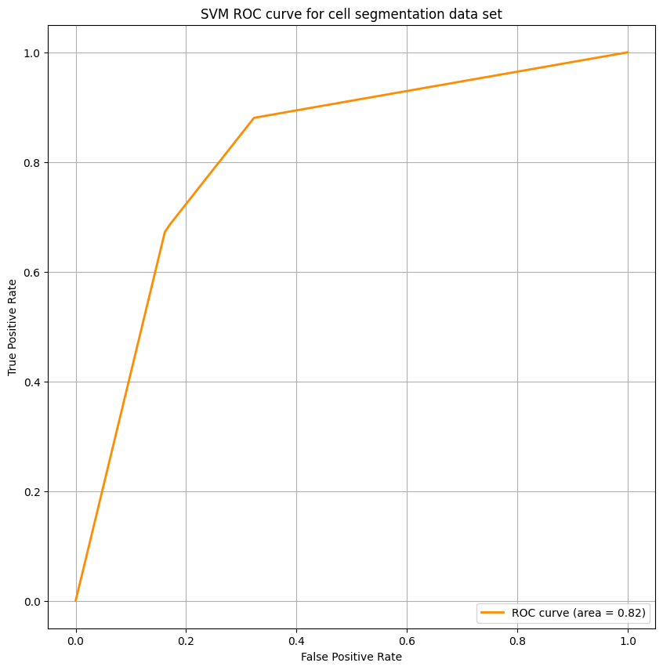
Decision trees Cell Segmentation example
Area under the curve: 0.816367521

Slide 21
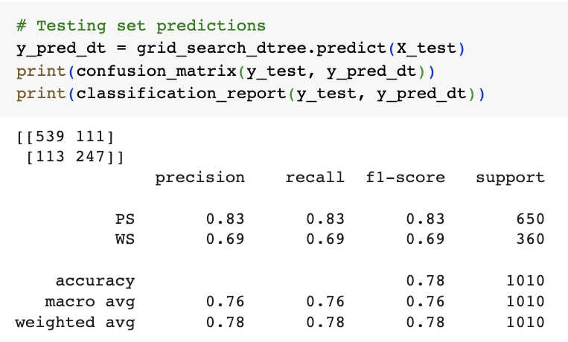
Decision trees Cell Segmentation example

Slide 22
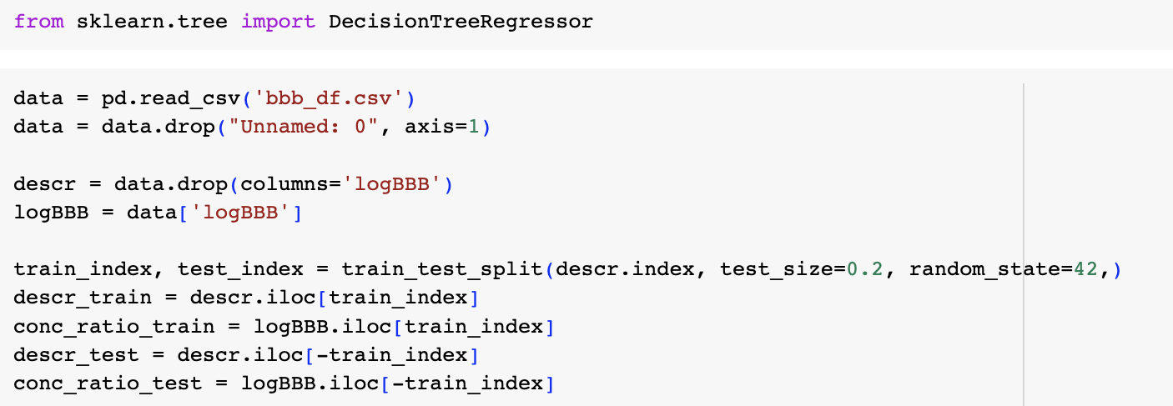
Decision trees Blood brain barrier example

Slide 23
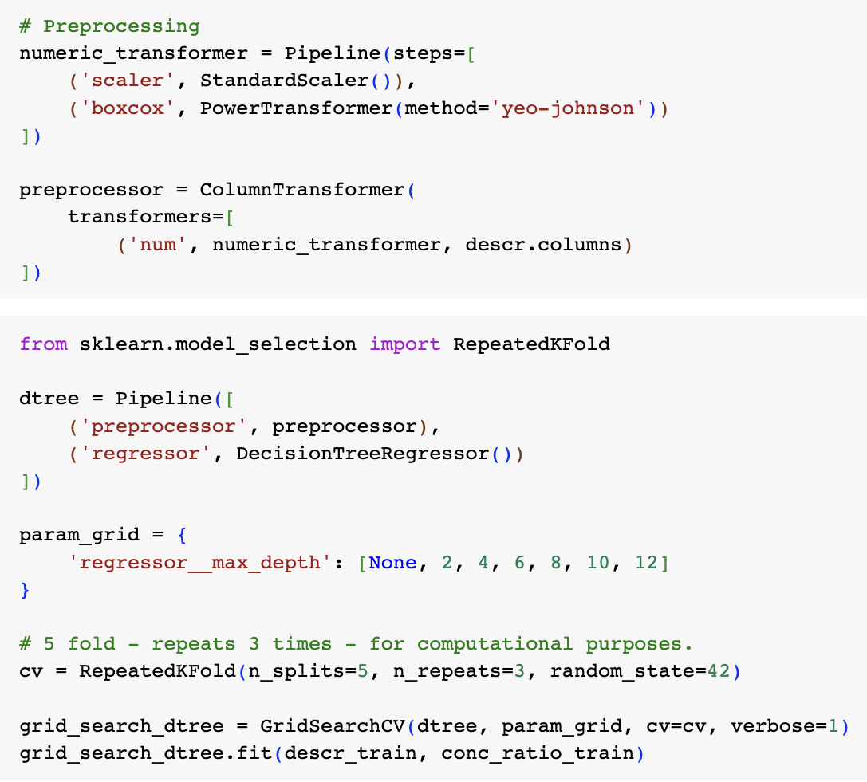
Decision trees Blood brain barrier example

Slide 24
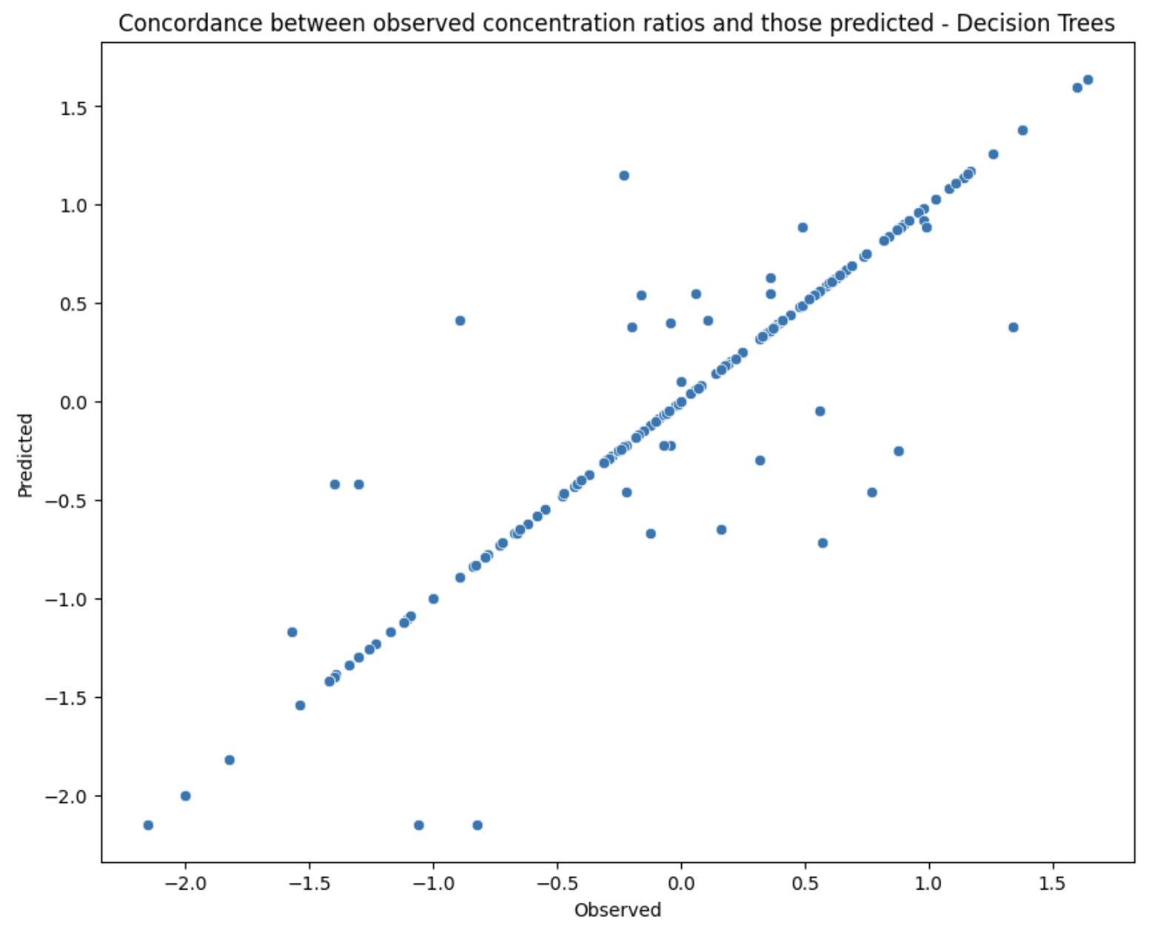
Decision trees Blood brain barrier example
Correlation between observed and predicted values (Decision Tree): 0.910

